Slide 1
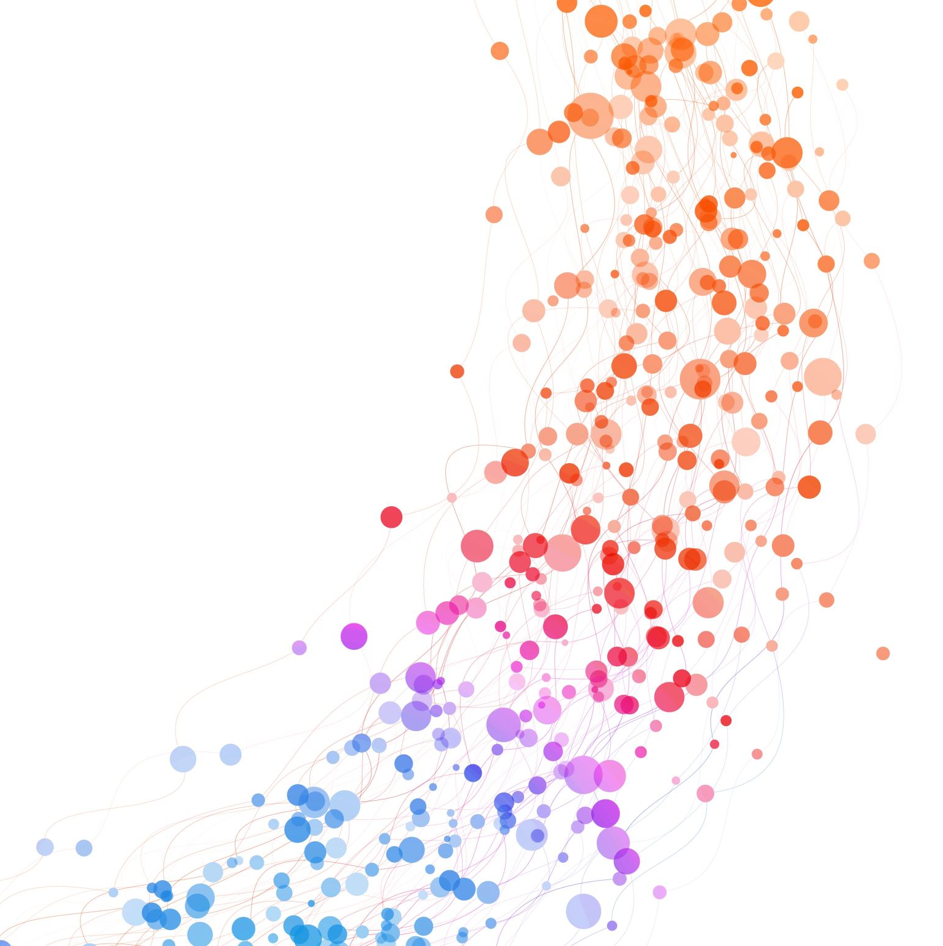
JS loops

Slide 2
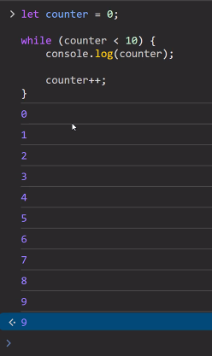
What is loops?
Loops can run endlessly (even crash it)
A loop need a configuration to run with limit. Usually use counter.

Slide 3
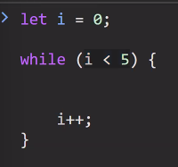
Loop are made of three parts
1. initialization
2.condition
3. increment

